Slide 1

Artificial Intelligence
Sadia Zafreen
GN2962
24CABSA101

Slide 2
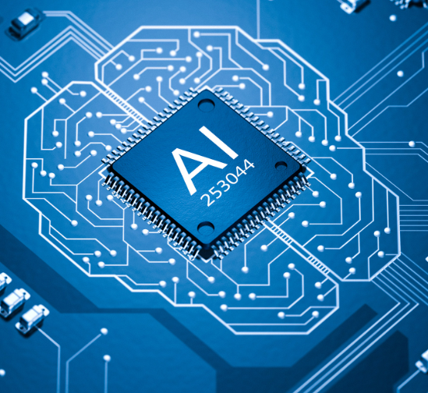
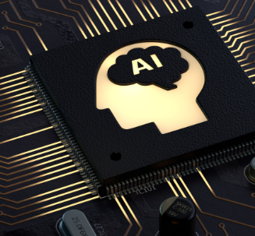
WHAT IS AI ?
AI refers to the simulation of human intelligence in machines that are programmed to think, learn, and problem-solve.
Advanced AI systems recognize patterns, and make decisions, often surpassing human efficiency in certain domains.
Machine Learning and Deep Learning: A key component of advanced AI is machine learning, where systems improve over time by learning from data.
NAME | Roll in AI development
John McCarthy | Father of AI, Computer Scientist
Geoffrey Hinton | AI Researcher, Cognitive Psychologist, Pioneer of Deep Learning
Fei-Fei Li | AI Researcher, Professor, Leader in AI for Social Good

Slide 3
How does AI differ from traditional computing in terms of decision-making and problem-solving?
Traditional computing relies on predefined instructions (if-then statements) written by programmers. AI, particularly machine learning, allows systems to learn from data and improve over time without explicit programming for every possible scenario.
In traditional computing, systems only perform tasks they are specifically programmed to handle. AI systems, however, can adapt to new situations, recognize patterns, and adjust their behaviour based on previous experiences or new information.
Traditional systems require human input for decision-making when encountering new or unforeseen problems. AI systems, however, can autonomously make decisions by analysing data, evaluating patterns, and predicting outcomes, often with minimal human intervention.

Slide 4
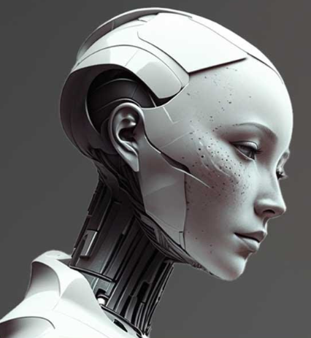
For More info visit Wikipedia

Slide 5
Thank you

